Slide 1

Services and Resources for FST Graduate Students
Dr. Dunwei Wen
Chair and Associate Professor
School of Computing and Information systems
Faculty of Science and Technology
November 8, 2022

Slide 2



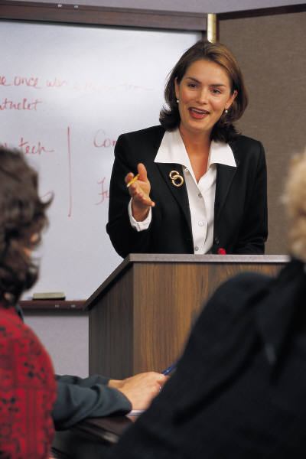




Office of the Registrar
Research Office
Faculty of Graduate Studies
Library
Athabasca
Landing
Faculty of Science and Technology
Course Study & Research
Admission and Start
Graduation & Convocation
Student Life
Graduate Application
Social Media
AUGSU
Alumni & Friends

Slide 3
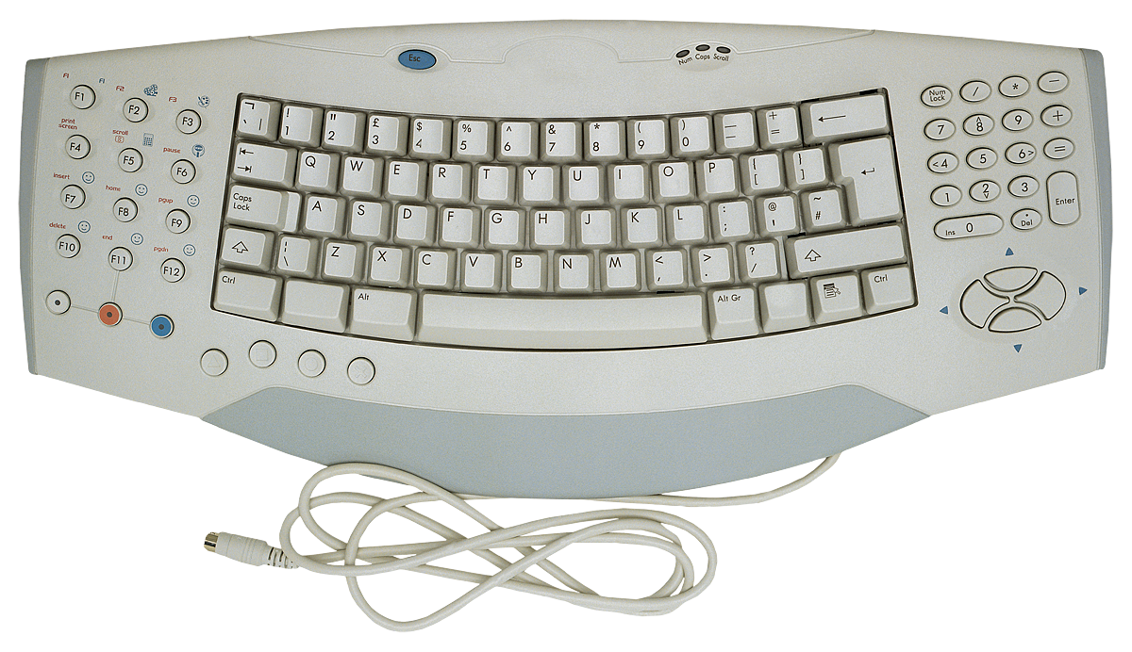
FST Contact and AU Technical Services
Hours: Mon – Fri, 8:30 am – 4:30 pm (MT)
Phone: 1-855-362-2870
Fax: (780) 675-6148
Email: fst_grad_success@athabascau.ca
For issues related to your access to the AU systems, including Moodle and myAU (IT Help Desk Website): https://www.athabascau.ca/support-services/about/technical-support/

Slide 4
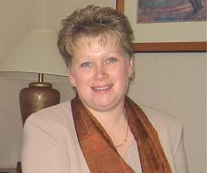
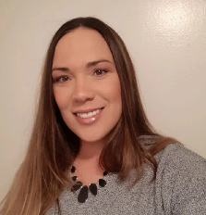
Administrative and Technical Support
SCIS (MSc IS, GC DA, GC IS, and GC ITM)
Linda Gray
Administrative Assistant and Program Advisor
Paula Stiles
Graduate Student Support and Advising Specialist
Architecture (Graduate Diploma in Architecture)
Carole Mason
Program Administrator
Emma Lowry
Student Support and Advising Specialist
fst_grad_success@athabascau.ca

Slide 5

Faculty of Science and Technology (FST)
https://www.athabascau.ca/science-and-technology/

Slide 6

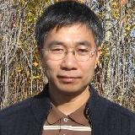
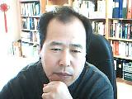
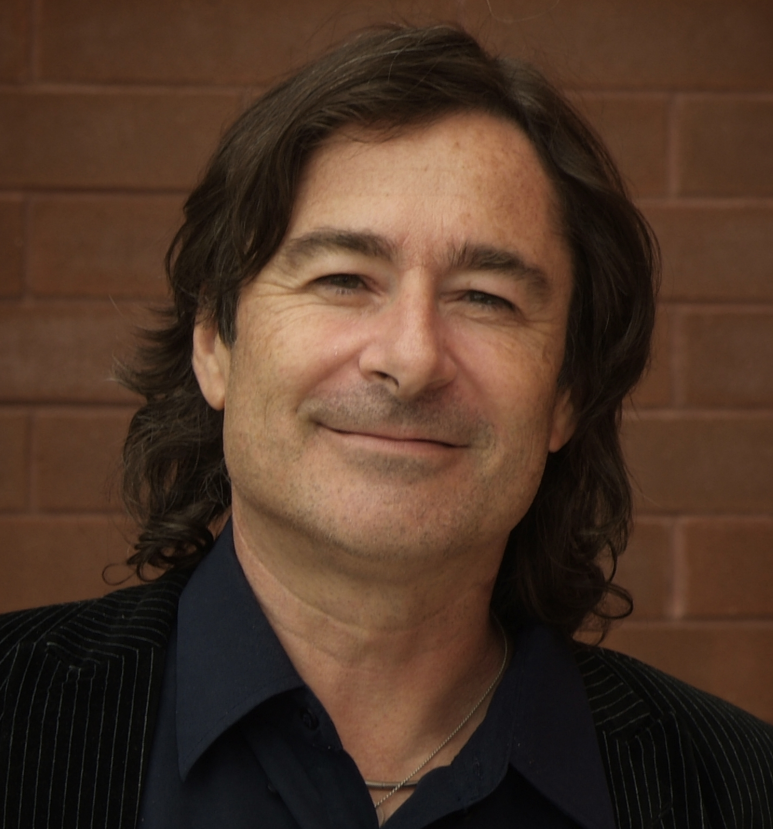
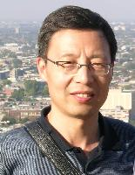

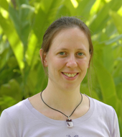

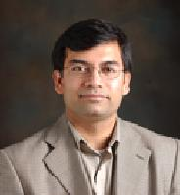
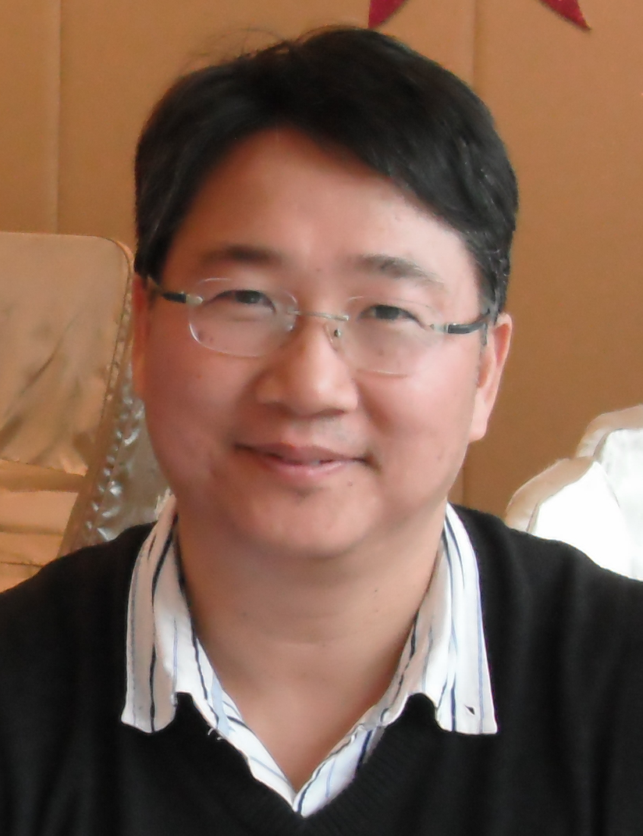
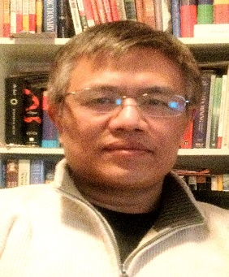
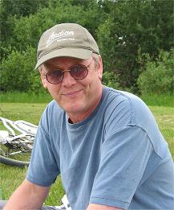
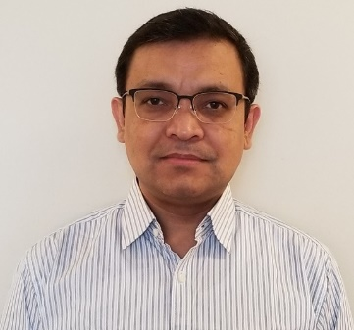
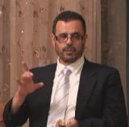
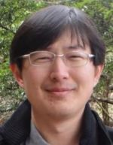
Faculty in the School of Computing and Information Systems
Larbi Esmahi
Dunwei Wen
Harris Wang
Jon Dron
Xiaokun Zhang
Stella George
Sabine Graf
Richard Huntrods
Vive Kumar
Oscar Lin
Qing Tan
Terry Taylor
Ali Dewan
Mahmoud Abaza
Maiga Chang
https://scis.athabascau.ca/

Slide 7
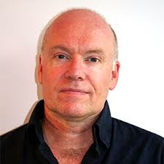

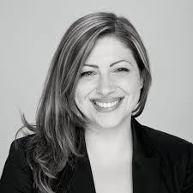
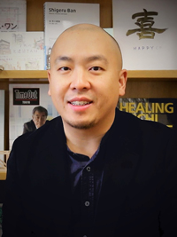

Faculty in RAIC Centre for Architecture
Douglas MacLeod (Chair)
Trevor Butler
Veronica Madonna
Henry Tsang
http://architecture.athabascau.ca/

Slide 8
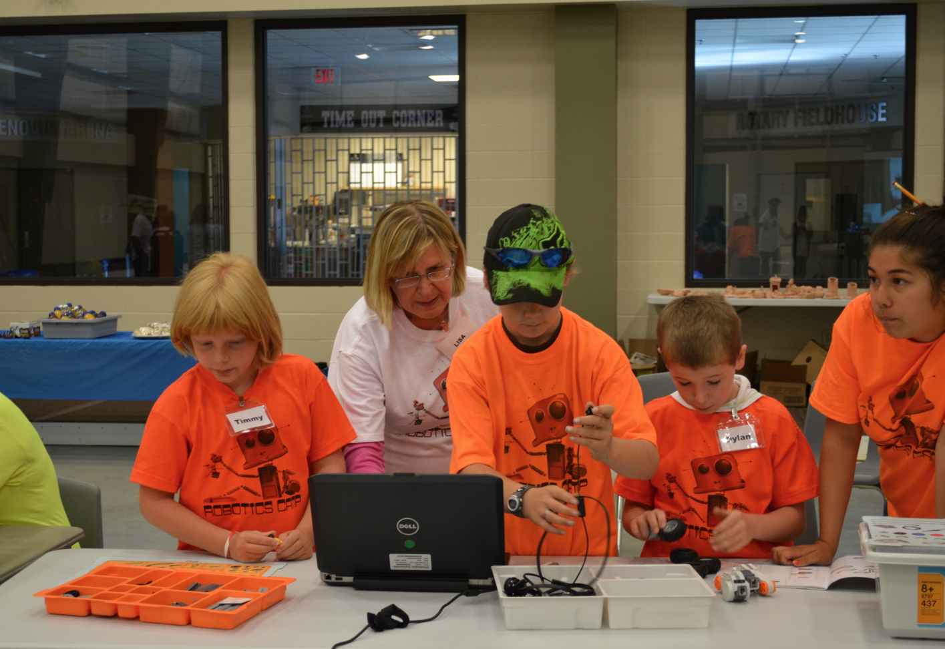
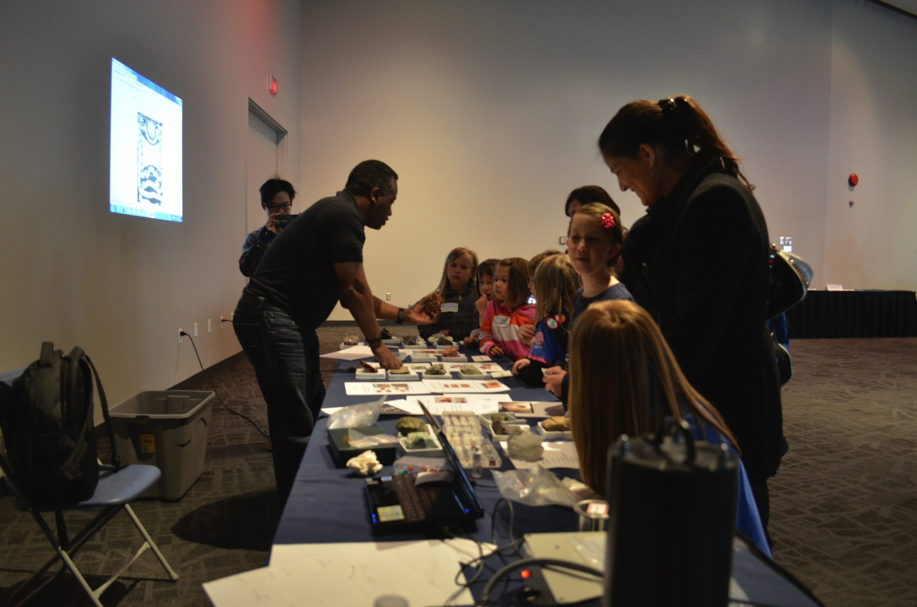
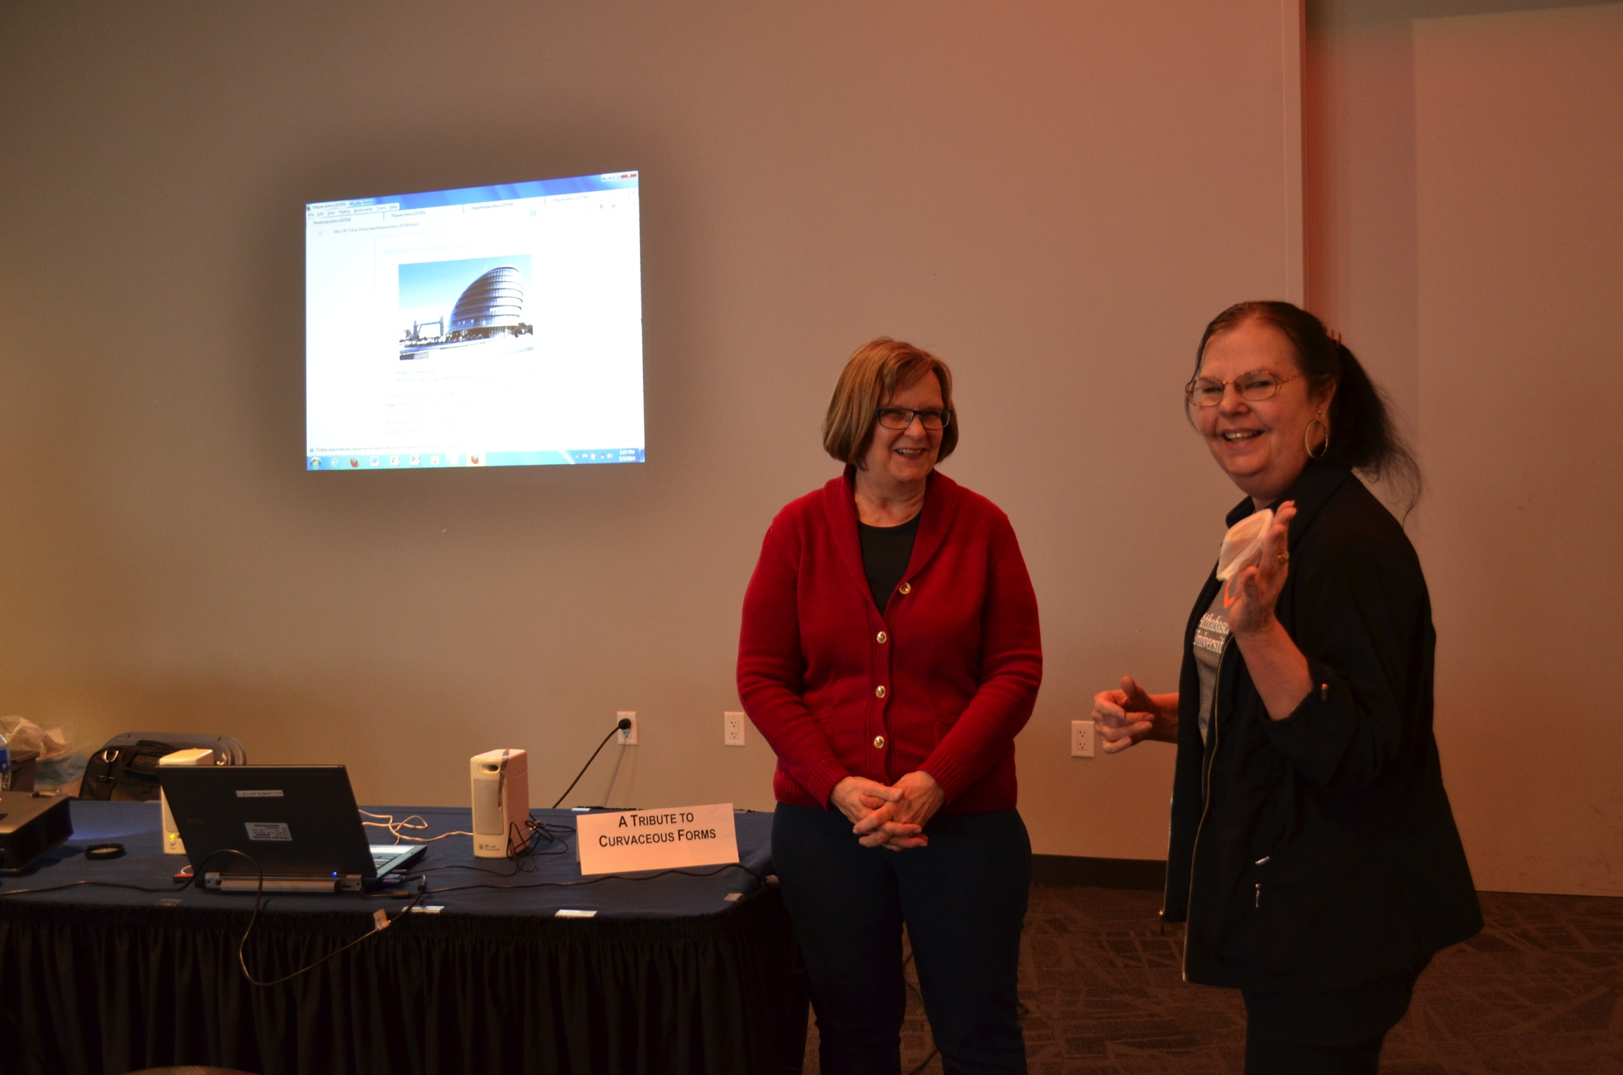
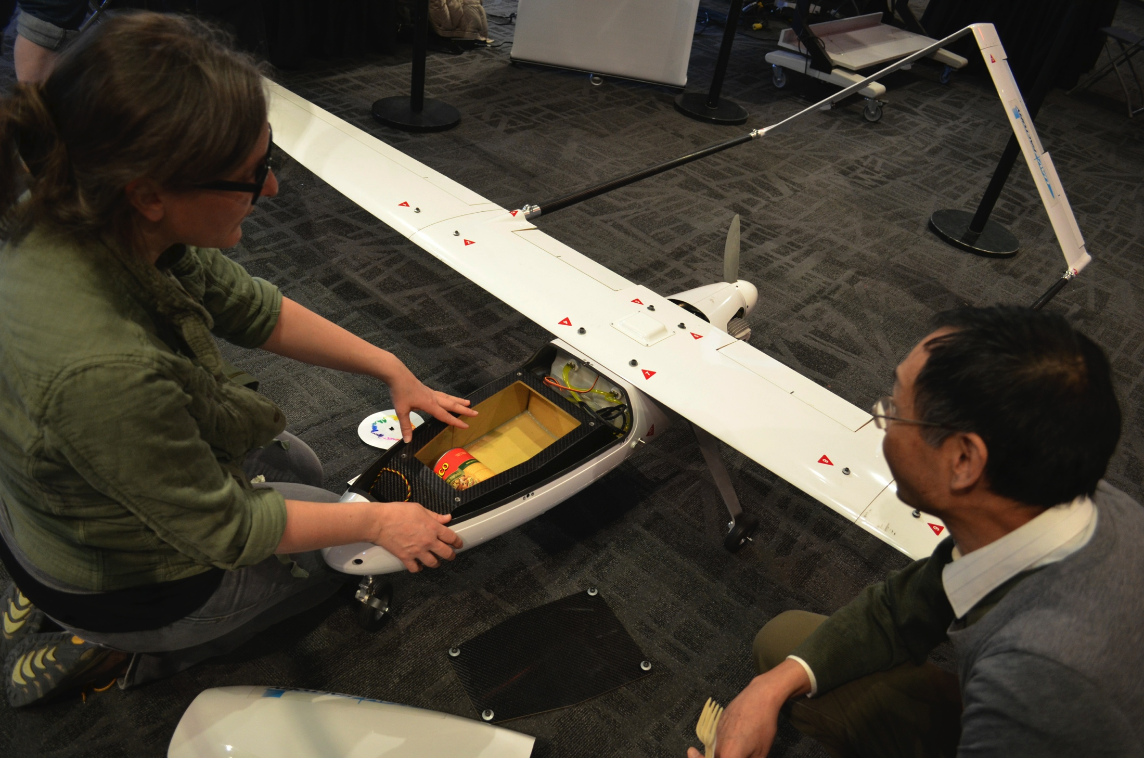
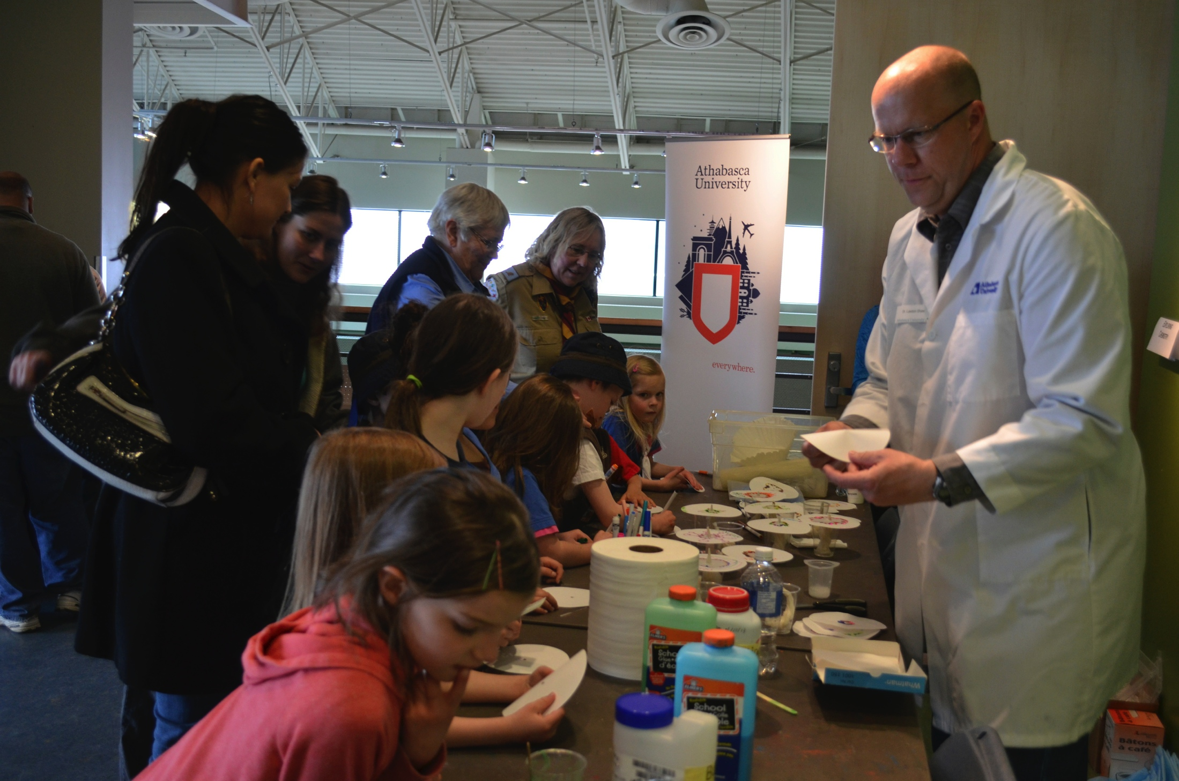
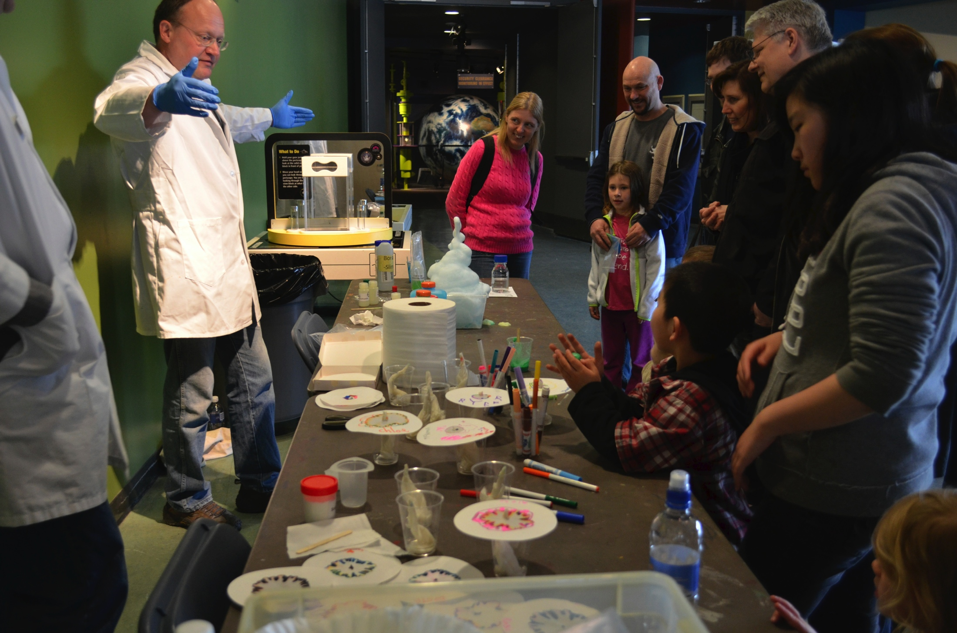
Faculty in Centre for Science
Shauna Zenteno (Dean, FST)
Ken Munyikwa (Associate Dean)
Lawton Shaw
Srijak Bhatnagar
Farook Al-Shamali
John Ulici-Petrut
Angela Beltaos
Gustavo Carrero (Chair)
Lisa Carter
Martin Connors
James Greenwood-Lee
Dietmar Kennepohl
Shawn Lewenza
Julie Peschke
Frederique Pivot
Norman Temple
Roland Treu
Tarah Lynch
Mustafa Avci
Junye Wang
Chris Glover
Scott Ketcheson
https://science.athabascau.ca/

Slide 9
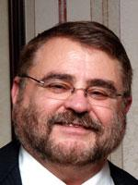
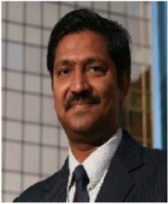
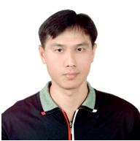
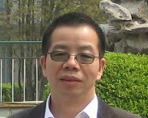
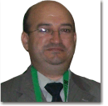
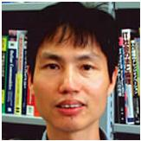
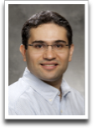
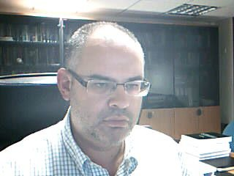
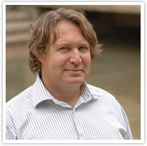
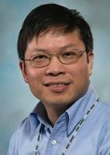
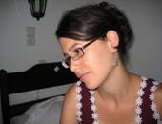
Adjunct Professors and Collaborators of SCIS
Michael Spector
(USA)
Kinshuk
(USA)
Nian-Shing chen
(Taiwan)
Ronghuai Huang
(China)
Mohamed Jemni
Tunisia
Qun Jin
(Japan)
Ebrahim Bageri
(Canada)
Demetrios G Sampson
(Greece)
George Siemens
(Canada)
Chunsheng Yang
(Canada)
Azmal Zouq
Canada

Slide 10
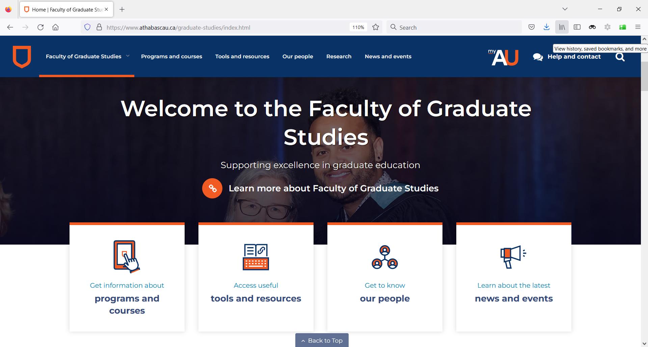
Faculty of Graduate Studies
https://www.athabascau.ca/graduate-studies/
Notes:
Some important roles FGS are
-- overseeing the design and delivery of programs
-- developing policies and standards for all graduate programs
-- providing resources to faculty and students
-- supporting diversity, equity, integrity, and ethical conduct in graduate education
The Graduate Handbook includes information on the policies and regulations that have been formally adopted by the Faculty of Graduate Studies

Slide 11
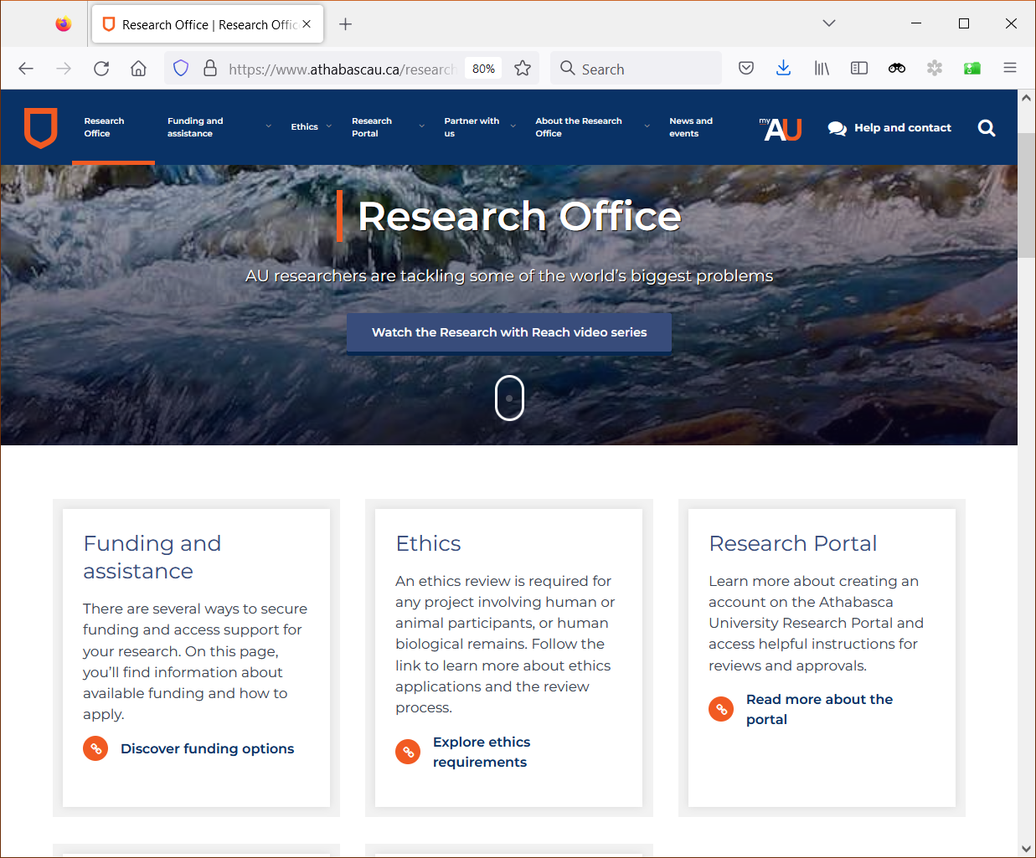
Research Office
https://www.athabascau.ca/research/
Notes:
Roles of AU research office:
publicizing prospective funding sources
supporting research grant applications
review and award internal research funding
the management of grant/award funding
the processing of ethics review for research involving humans and animals
the development of academic-industry partnerships
the planning and hosting of research-related events

Slide 12
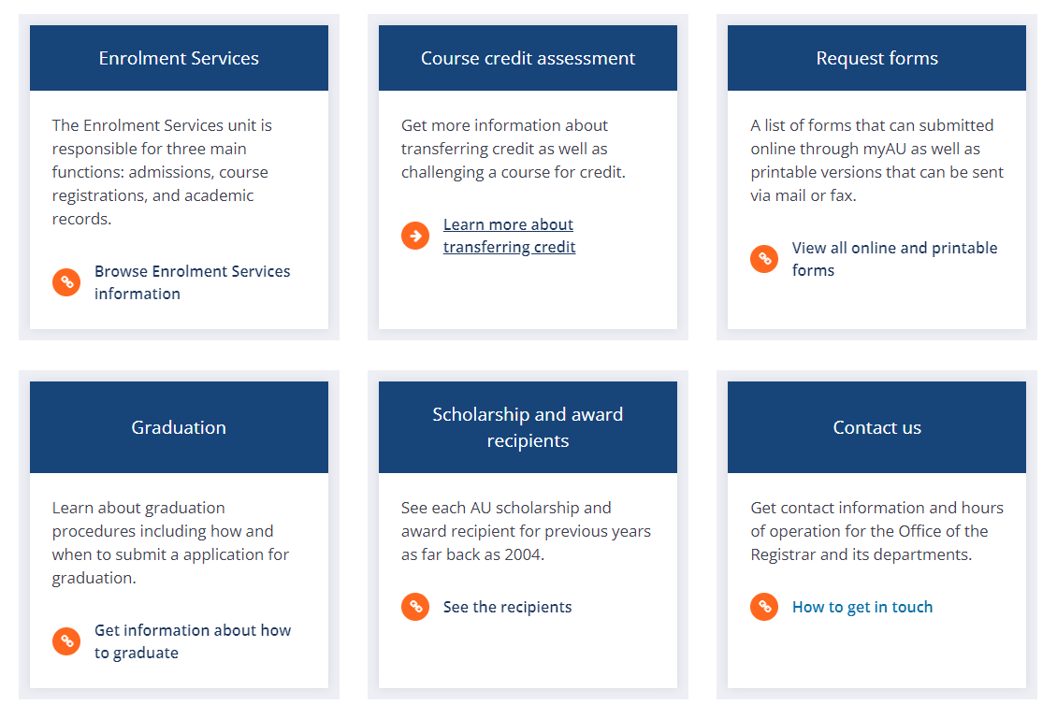
Office of the Registrar
https://www.athabascau.ca/registrar/index.html
Notes:
The Office of the Registrar is responsible for many of AU’s student services.
enrolment, credit transferring, graduation services
maintain student records
maintain the AU Calendar

Slide 13
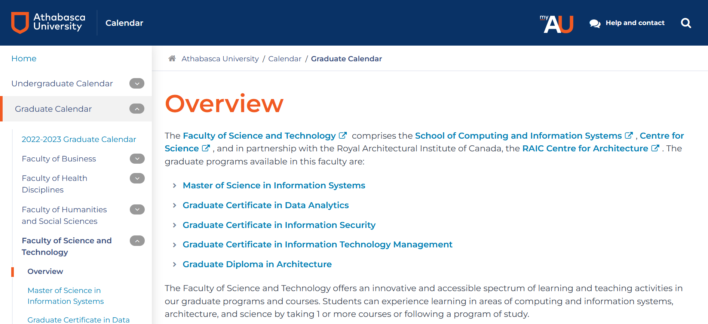
Graduate Calendar (AU, FST)
https://www.athabascau.ca/calendar/graduate/fst/index.html

Slide 14
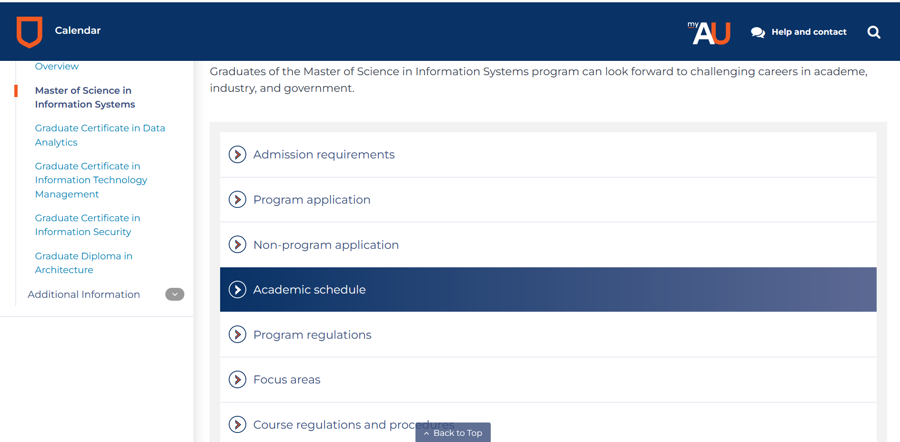
Graduate Calendar: MSc IS
https://www.athabascau.ca/calendar/graduate/fst/master-of-science-in-information-systems.html

Slide 15
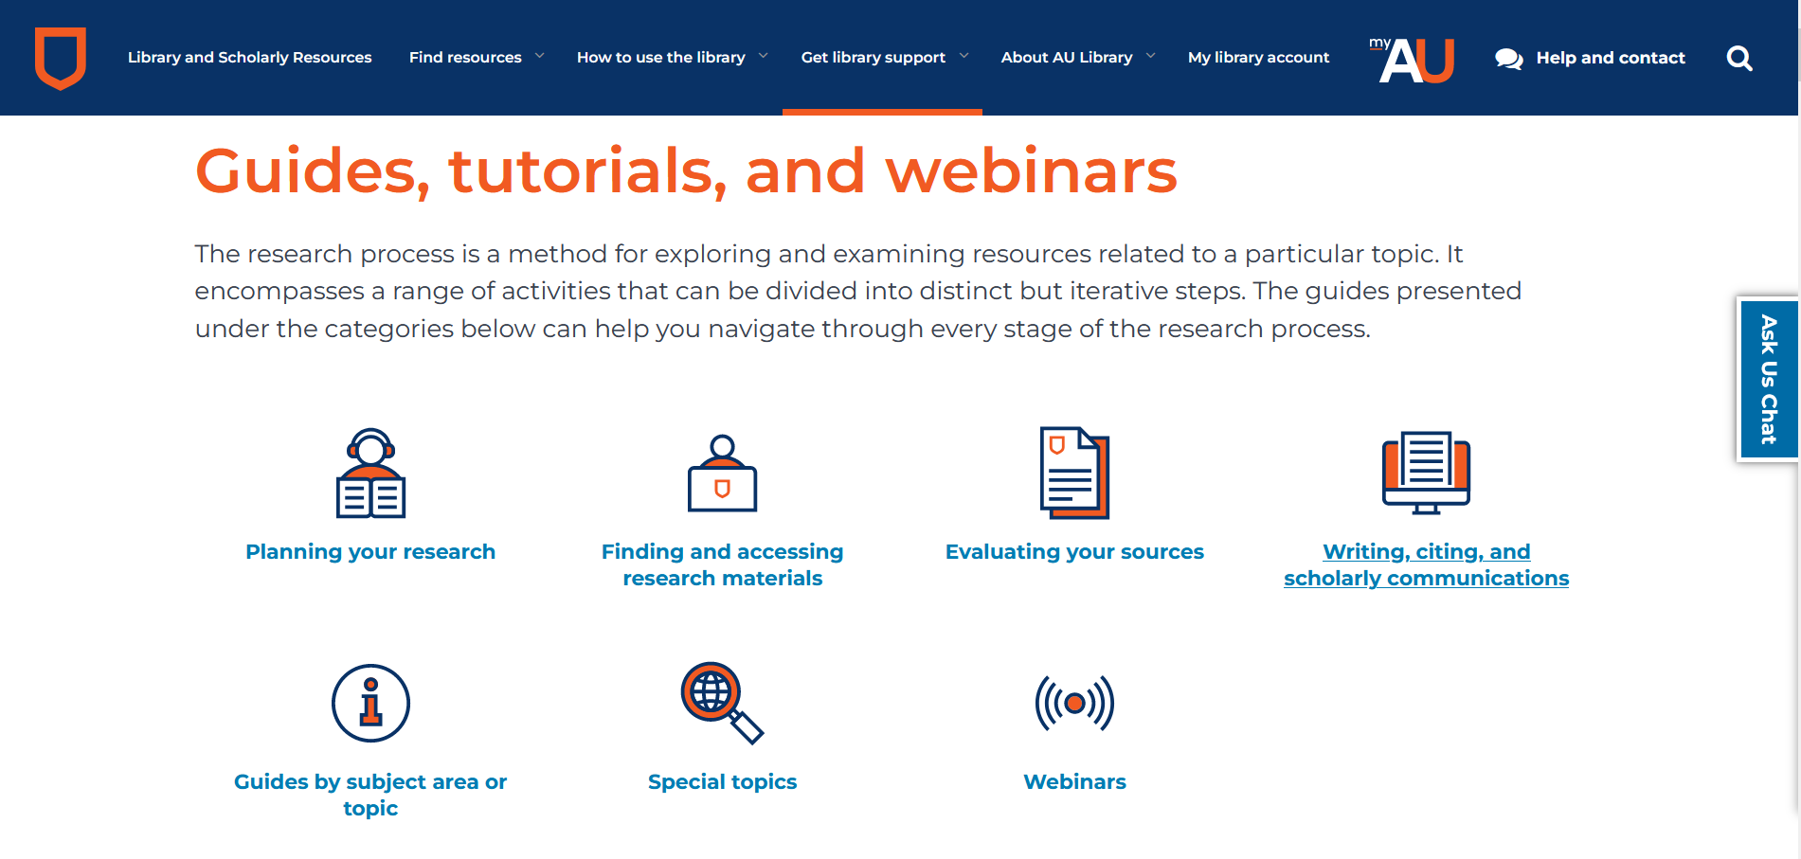
Library
https://www.athabascau.ca/library/how-to-use-the-library/index.html
Library Orientations https://www.athabascau.ca/library/orientations/index.html

Slide 16
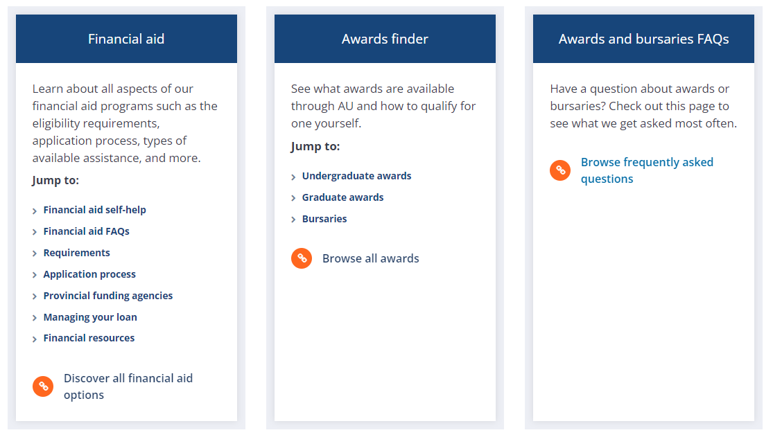
Funding Opportunities
Faculty of Graduate Studies:
https://www.athabascau.ca/graduate-studies/about/graduate-funding.html
Research Centre:
https://www.athabascau.ca/research/funding-and-assistance/find-and-apply-for-funding/graduate-student-funding.html
Financial Aid and Award:
https://www.athabascau.ca/support-services/financial-aid-and-awards/index.html

Slide 17
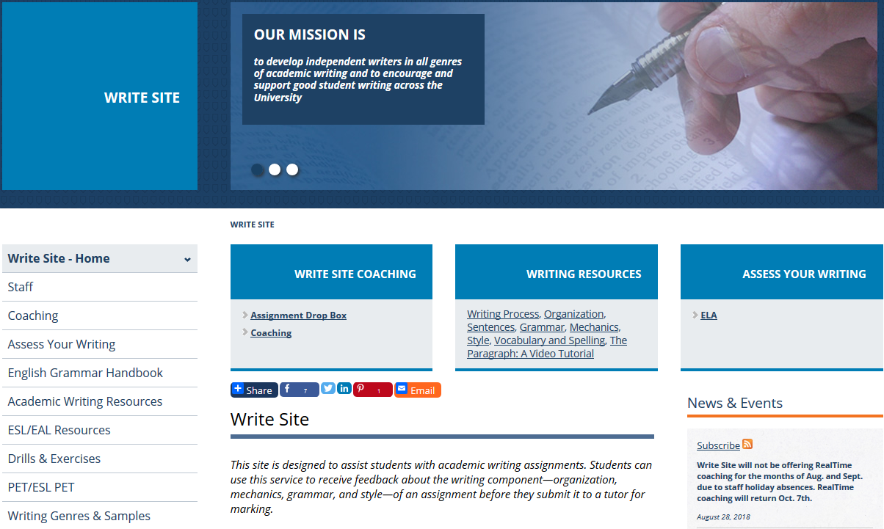
The Write Site
https://www.athabascau.ca/write-site/
Notes:
The Write Site’s services are here to support students with academic writing.
With support from the Write Site’s writing coaches, you can discuss your writing questions and receive feedback about the writing aspects of your assignments.
Writing coaching is usually most helpful when your goal is to develop your writing skills within the context of course work over time.

Slide 18
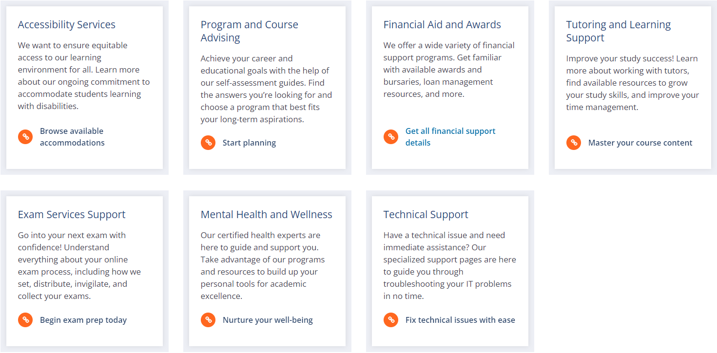
Support Services at Athabasca University
https://www.athabascau.ca/support-services/

Slide 19
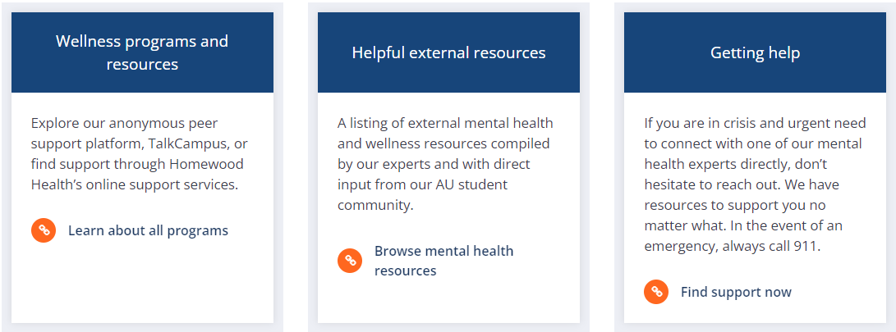
Mental Health and Wellness
https://www.athabascau.ca/support-services/mental-health-and-wellness/index.html
Notes:
-- talking to a professional counsellor
-- using the tool TalkCampus

Slide 20
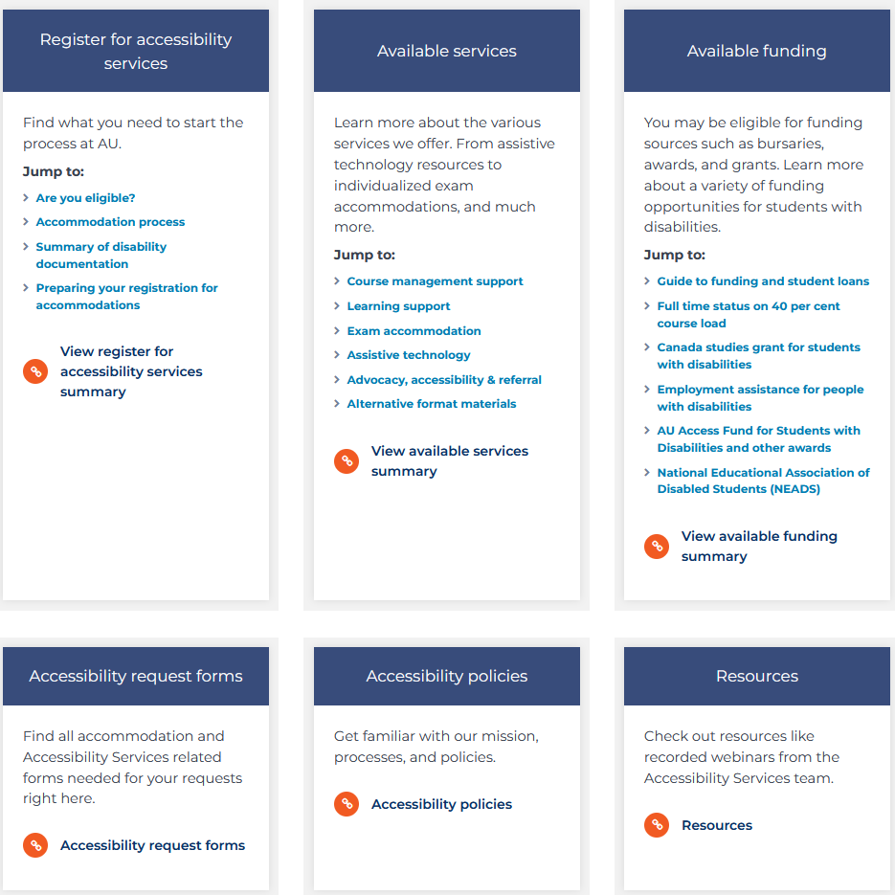
Accessibility Services
https://www.athabascau.ca/support-services/accessibility-services/index.html
Notes:
Assist students who require academic accommodations
Browse this section to discover our services and resources from assistive technology to individualized exam accommodations
Explore our services and find out how to register for accessibility services

Slide 21

Some Useful Landing Groups
SCIS
https://landing.athabascau.ca/groups/profile/11704/scis
AU Graduate Students Association:
https://landing.athabascau.ca/groups/profile/15119/augsa
SCIS Graduate Students
https://landing.athabascau.ca/groups/profile/2101501/scis-graduate-students
Programming and Problem Solving
https://landing.athabascau.ca/groups/profile/40571/programming-problem-solving

Slide 22

Any questions?
Dr. Dunwei Wen (Chair, SCIS)
dunweiw@athabascau.ca

