Slide 1
FST Research
Approaching, Sustaining, and Breaching The Knowledge Frontier
Dr Vivekanandan Kumar
Dr Stella George
Notes:
.
.
.
.
.
.
.
.
.
.
As a Higher Education Institution, our responsibility as researchers and students is to approach the knowledge frontier, sustain at the knowledge frontier, and try to breach it, to augment existing knowledge.
We are here not just to study what is already there but to go beyond it. In the next 10 minutes, I ‘ll outline how to approach, sustain, and breach the knowledge frontier.

Slide 2
Approaching Knowledge Frontier
“…to extend human knowledge beyond what is already known. An individual’s knowledge enters the domain of science only after it is presented to others in such a fashion that they can independently judge its validity” - (National Academies of Science, Engineering and Medicine, NA Press, “On Being a Scientist” 1995)
“Indigenous knowledge” as a term that refers to a set of complex knowledge systems based on the worldviews of Indigenous peoples. Indigenous knowledge reflects the unique cultures, languages, governance systems and histories of Indigenous peoples from a particular location. Indigenous knowledge is dynamic and evolves over time. It builds on the experiences of earlier generations and adapts to present conditions. First Nations, Inuit and Métis each have a distinct way of describing their knowledge. Knowledge-holders are the only people who can truly define Indigenous knowledge for their communities - (Govt. of Canada)
Notes:
There are two ways to approach the knowledge frontier. Knowledge can conceived and shared to a third party to judge its validity before being included as part of the knowledge tapestry.
As indigenous communities around the world have shown us, another way to approach the frontier is when members of a community empower and follow knowledge holders to accumulate and disseminate knowledge.
In the first approach, knowledge seemingly grows outward. Indigenous methods have shown the potential of knowledge accumulating inward.
As you pursue the knowledge frontier, you may want to consider both approaches.

Slide 3
Passion, Creativity, and Picking a research area/topic
RESEARCH CLUSTERS/Groups
User Adaptive Systems
Intelligent Systems and Machine Learning
AI Agent Virtual Lab
Cyber-Physical Systems
Regenerative Design and Sustainability
Northern Ecosystems
ARBRI
Notes:
The CIS Knowledge frontier is enormous, full of research areas and topics. FST professors have created a list of over 100 topics of their interest. The AU Library has thousands of collections of thesis topics. To pick one of your own, you need to first find your passion for that topic. You are most welcome to find a topic of your own. Many of you have the industry background already. It is quite feasible to find a topic that matches your personal interest and also aligns well with your professional interests.
A simpler way to find a research area or topic is to join a research cluster or group. FST has 3 clusters and many informal groups. AU has its one and only Research Institute called ARBRI – Athabasca River Basin Research Institute where members pursue research in water health, environmental impact, zero carbon, climate change, social impact, technology and the environment, and so on. Depending on one’s interest, it is advantageous to associate with a cluster or a group from day 1 of grad studies. This way, you get to know the topics that are being pursued by the cluster/group, and elsewhere. Plus, you also get to know how to approach a research topic and gain a core understanding about conducting research.
Research Plan as part of ‘COMP695 – Research Methods’ course
https://triton2.athabascau.ca/research/graduate/viewTopics.php

Slide 4
At the Knowledge Frontier
As part of a research cluster/group/institute, maintain a continuous flow of incoming literature and waves of analyses. Clusters, by nature, tend to attract other similar structures forming a network.
Meta analyses should be a regular activity in a cluster.
To be data-informed and proactive, research activities should become ‘traceable’ in terms of portfolios, datasets, models, and arguments. Trace your article writing, coding, design, reading, synthesizing, …
Research productivity or acknowledgement by a knowledge holder can be measures of one’s proximity to the knowledge frontier.
Notes:
After approaching the knowledge frontier for some time, how would you know that you have reached the frontier? What to do at the frontier?
Well, as part of the cluster/group/institute, you should maintain a continuous flow of incoming literature and waves of analysis. At the recent Pan-Commonwealth Forum conference, we came across a publication by the conference organizers that offered a second-order meta analyses on Technology Application in Teaching and Learning. That is, it has compiled a set of meta analysis on the topic and has conducted an analysis on them. If you understand this report then you can boldly claim to be at the knowledge frontier on Technology Application in Teaching and Learning.
At the ‘knowledge frontier’, every student researcher and the thesis committee should be wondering – ‘are we there yet’? How far away is the student from the frontier? Does the thesis aim to significantly expand the frontier to deserve a MSc/EdD degree? Did we engage the student sufficiently to help gain key research competencies? Did we guide the student sufficiently to become a better researcher? Answers to these questions will let the student and the committee know that they have arrived at the frontier.
Importantly, one should be able to track or trace the journey when reaching the knowledge frontier. As a student researcher, you may want trace everything – the drafts of your writing, the datasets you have dealt with, the articles you have read, the arguments you have made, versions of code you have written, designs you have conceived, … everything can be traced, recorded, indexed, and kept in your e-portfolio. Your portfolio need not only be the summative outcomes of your research accomplishments, but also the formative process and the intermediate products.
The research productivity is also a measure of one’s proximity to the knowledge frontier. If my meta-analysis has been accepted for publication, then naturally one can believe that I’m at the knowledge frontier. If the knowledge holder acknowledges and agrees with an argument, then it can be seen as one at the knowledge frontier.

Slide 5
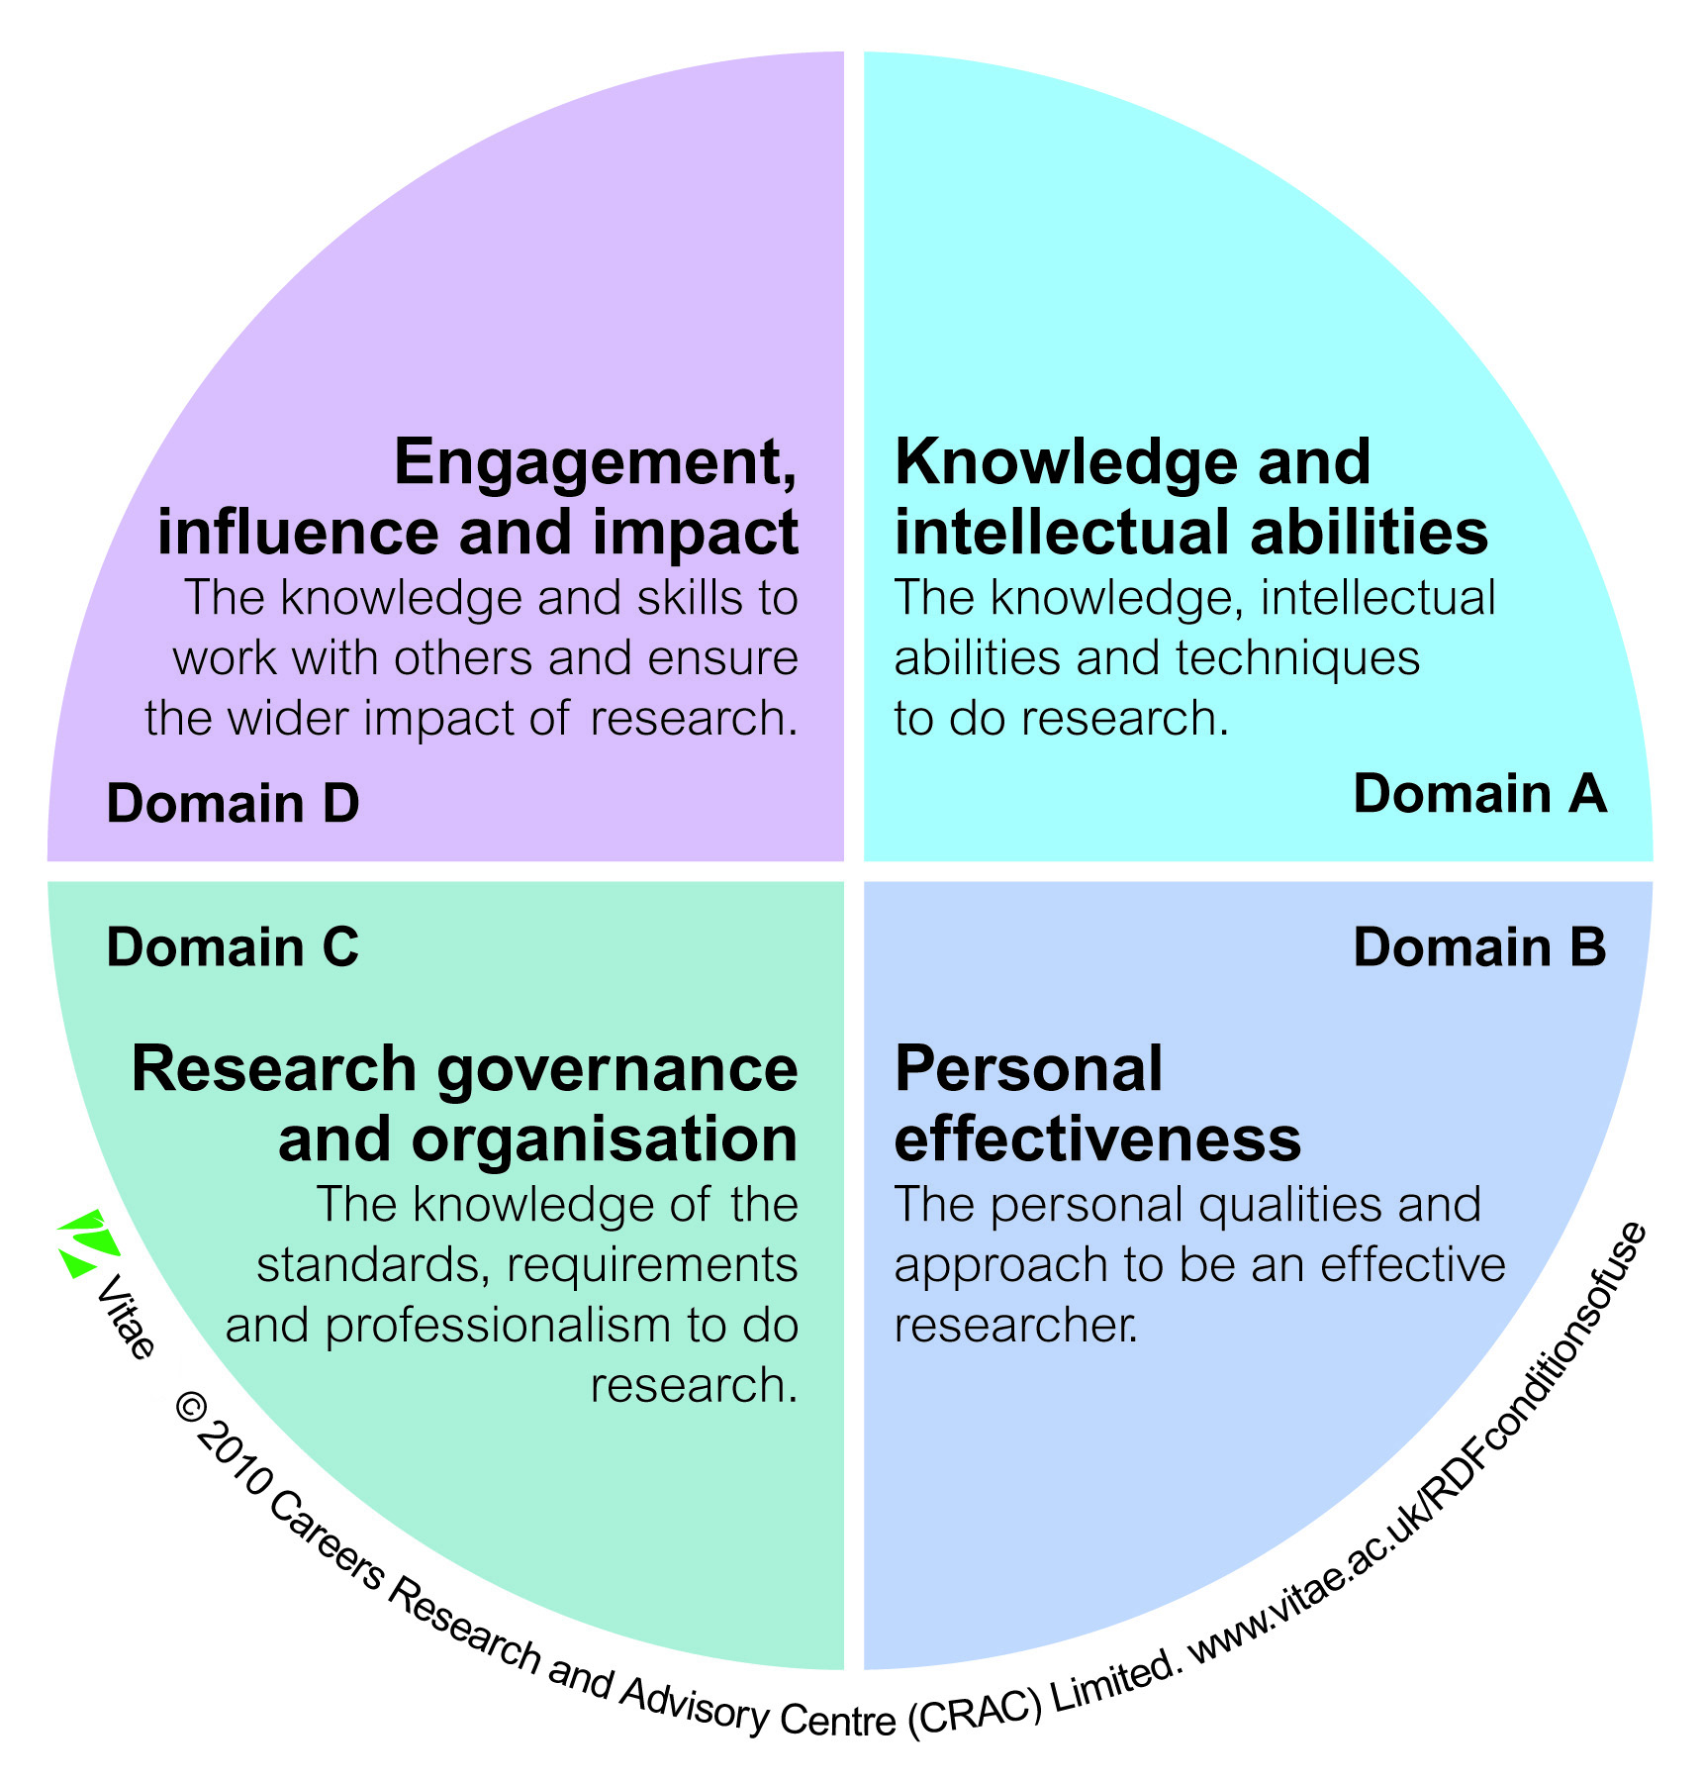
Researcher Development Framework to Breach the Knowledge Frontier
Notes:
To breach a knowledge frontier, one must reflect not only on the knowledge and intellectual abilities, but also other characteristics of a seasoned researcher. A framework for researcher skills called “Researcher Development Framework” has been developed in the UK. These characteristics are identified under these four domains – knowledge and intellectual abilities, personal effectiveness, research governance and organization, and engagement, influence and impact. Not only a researcher is expected to show competency in these domains but also showcase evidences in support of those competencies. In a way, one can instantiate the RDF with research traces and call in a research e-portfolio.

Slide 6
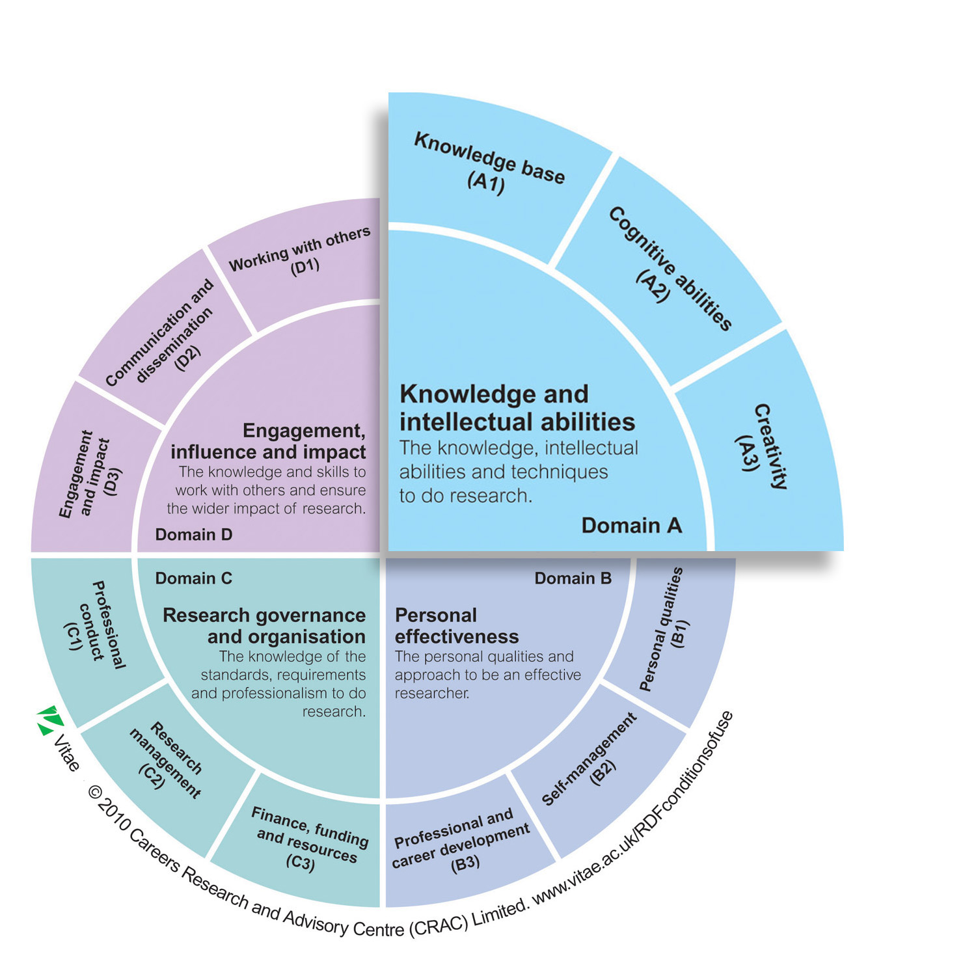
Researcher Development Framework to Breach the Knowledge Frontier
Notes:
Each domain is split further into sub-domains.

Slide 7
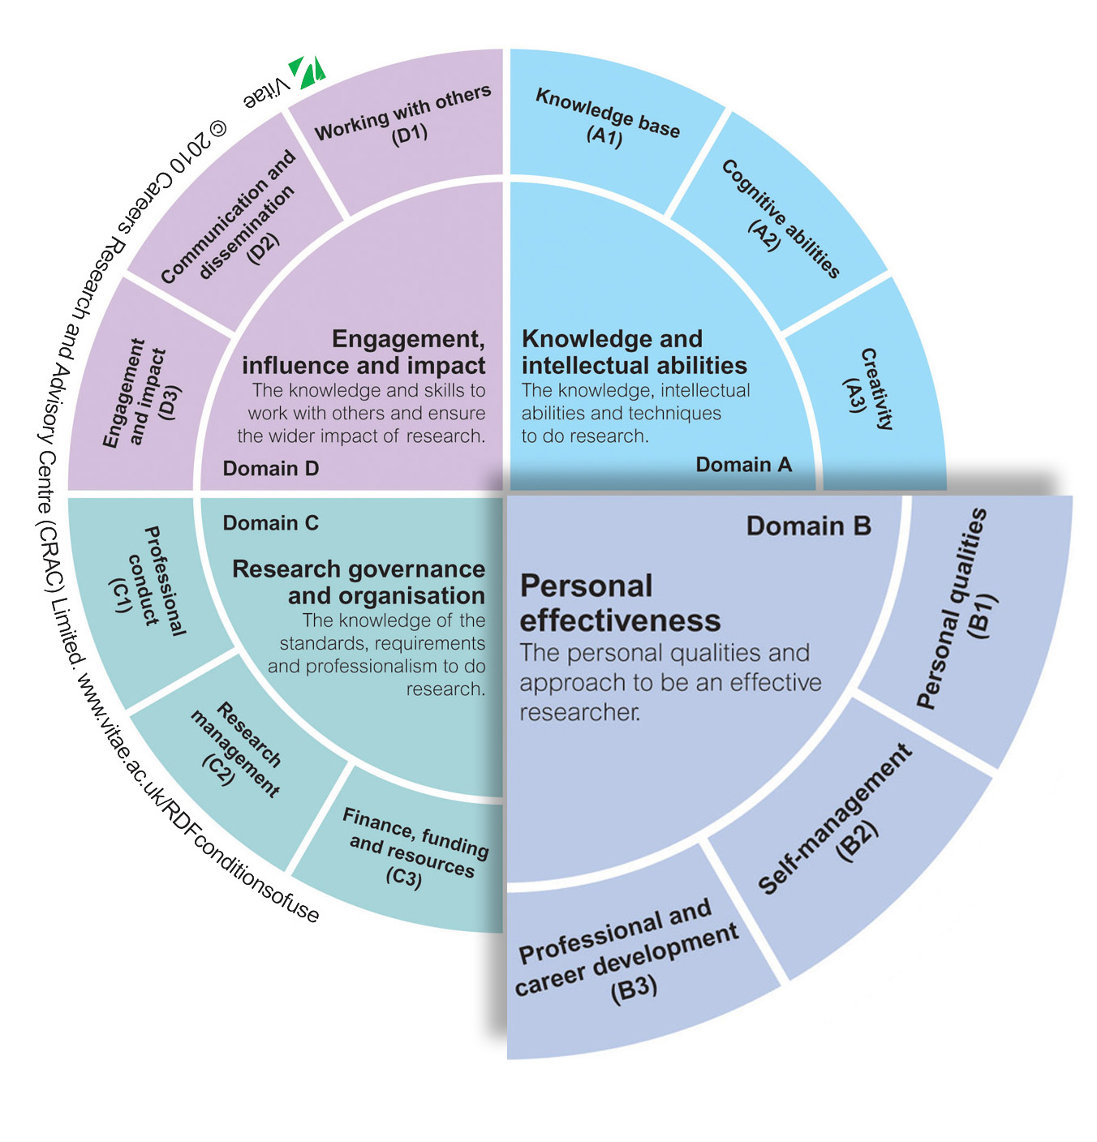
Researcher Development Framework to Breach the Knowledge Frontier

Slide 8
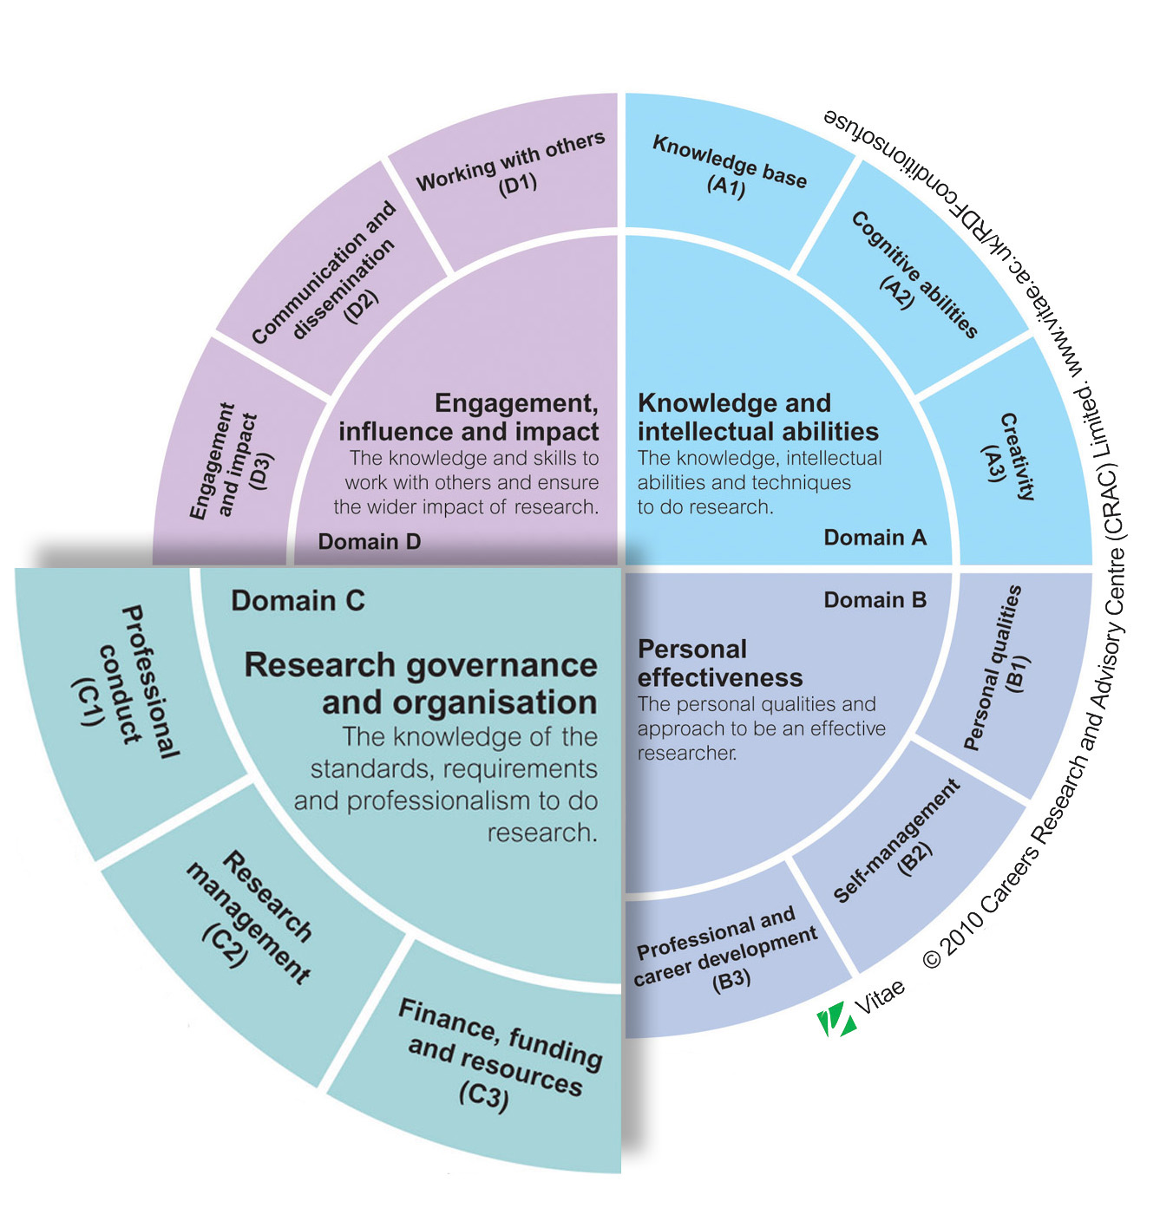
Researcher Development Framework to Breach the Knowledge Frontier

Slide 9
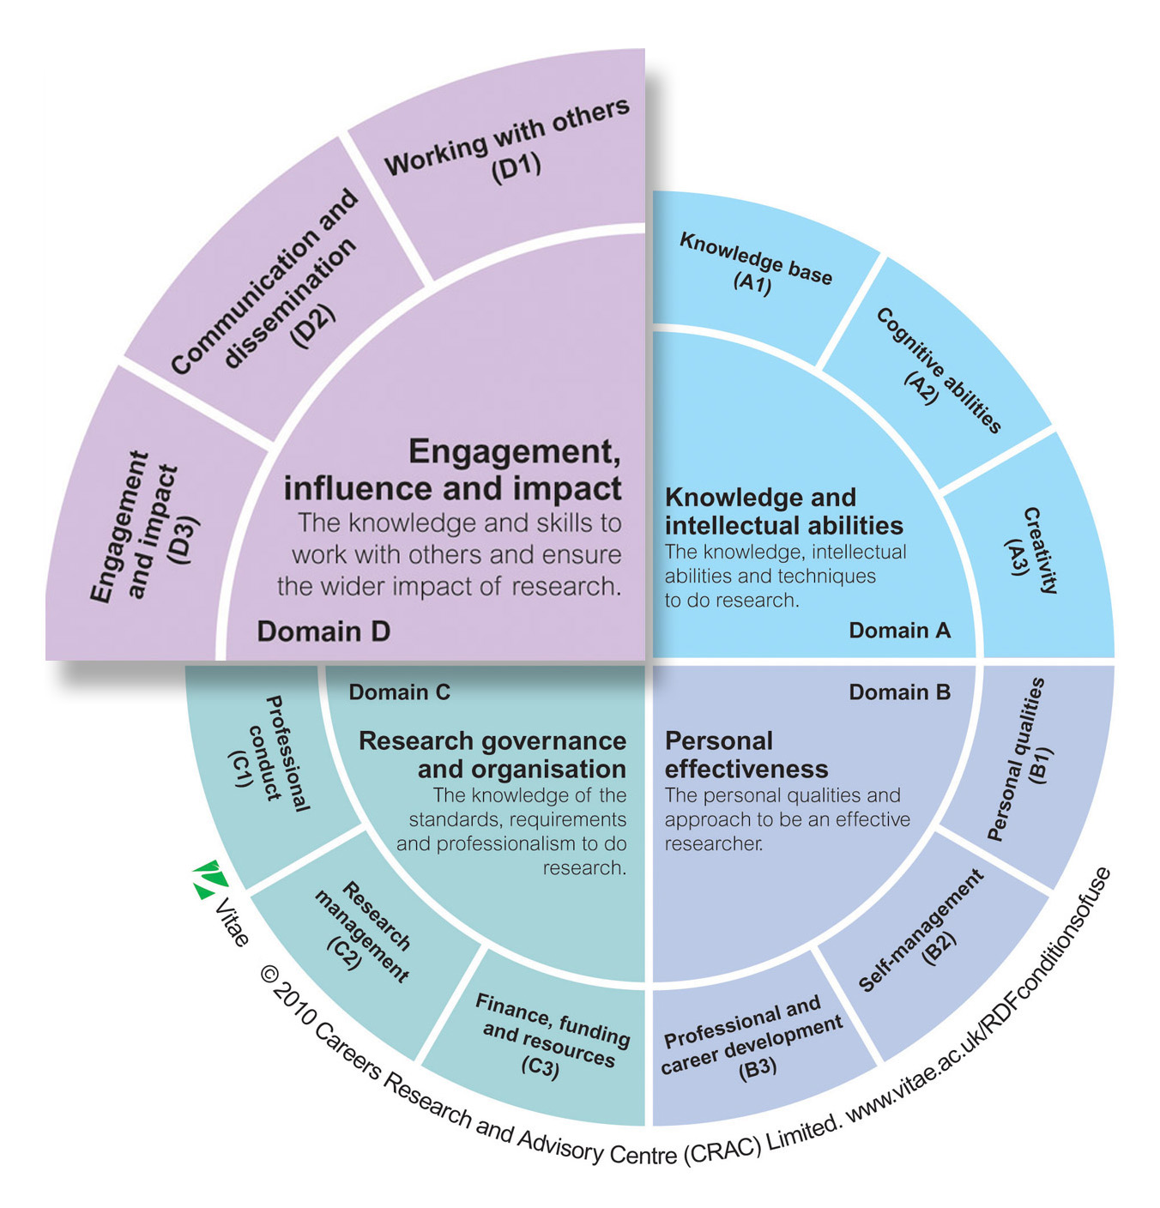
Researcher Development Framework to Breach the Knowledge Frontier

Slide 10
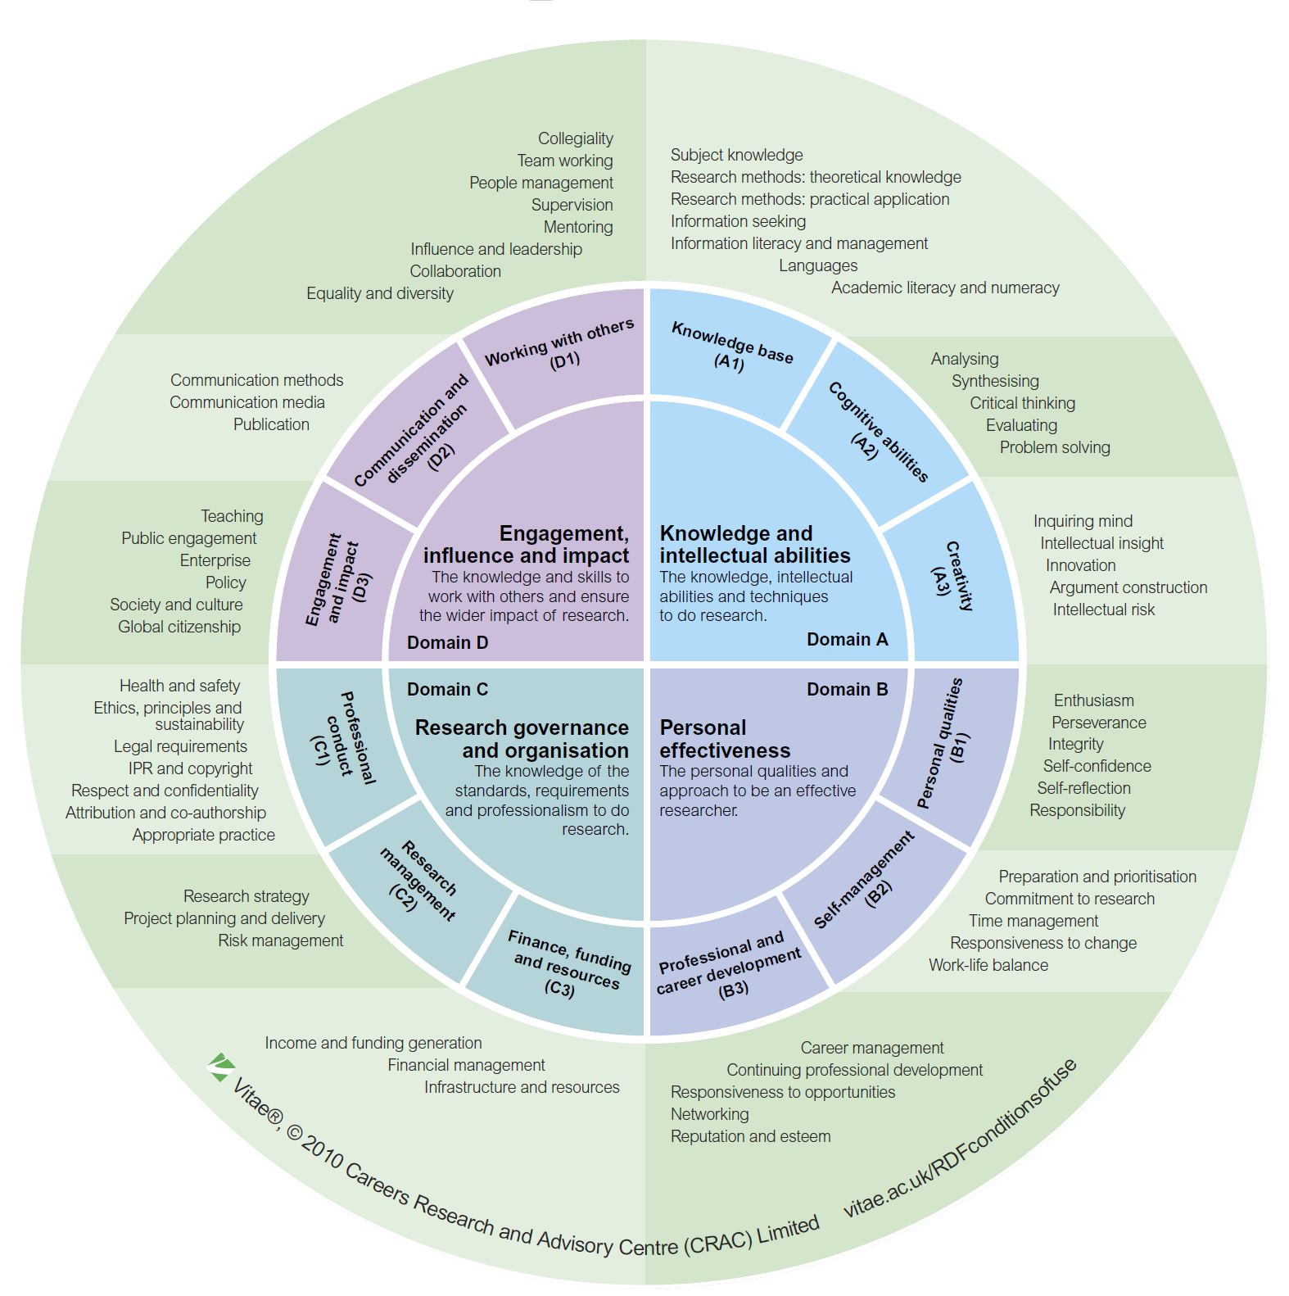
Researcher Development Framework to Breach the Knowledge Frontier
Notes:
And, each subdomain is further divided into target competencies.
Once instantiated, a research e-portfolio can be measured to determine if that person has indeed breached the research frontier.
This Researcher Development Framework is freely available online for anyone to use. (https://www.vitae.ac.uk/researchers-professional-development/about-the-vitae-researcher-development-framework). The latest version of Mahara, the e-portfolio tool, includes this RDF framework as a SmartEvidence feature.

Slide 11
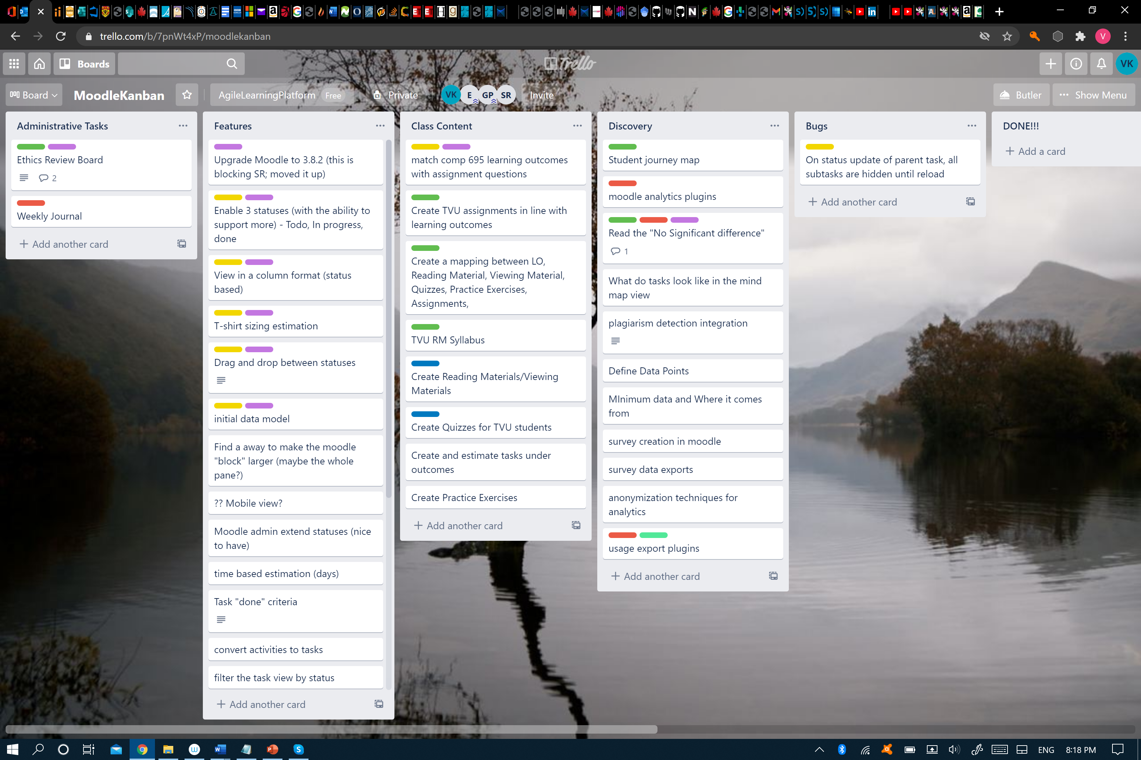
Notes:
Jira, Trello, Miro – suite of agile tools that can be used by the supervisory committee to guide

Slide 12
Breached Frontier
Becoming independent and self-sustaining researchers, in clusters and networks
Maintaining a healthy research-life balance
Seeking career potentials through experiential learning, RAships, internships…
Publishing in formal (top journals) and informal (TheConversation.com, DORA)
Trace the evolution of research competencies; Mahara has a built-in SmartEvidence for RDF; traces could be about reading, writing, designing, synthesizing, discussing, collaborating, watching, coding, presenting, or any other research related activity
Notes:
Progress of a researcher can be measured to determine if a researcher is self-sustaining, if a researcher maintains a healthy research-life balance, if a researcher seeks career potentials, if a researcher publishes in quality channels, if a researcher continues to trace the evolution of personal research competencies, and so on.

Slide 13
Tools of the Knowledge Frontier
    Researcher development framework (https://www.vitae.ac.uk)
    Auto Structured Lit Review (https://rpubs.com/WesSauder/760002),
    References management (JabRef, …),
    Open data repositories (osf.io/fxvru/; registry.opendata.aws/),
    E-Portfolio (Mahara SmartEvidence, …)
    Research Data Management (canarie.ca/rdm)
    Research Analysis (SPSS, R, NVivo, AWS, MS, …)
    Agile Learning (Jira, Miro, Trello, …)
    …
Notes:
Several tools exist to help approach the knowledge frontier, for activities at the knowledge frontier, and to breach the knowledge frontier. I have listed some here.
{highlight some}
I hope I have shared an evidence-based, traceable pathway to become a successful researcher, who knows how to approach the knowledge frontier, how to sustain a knowledge frontier, and how to breach a knowledge frontier.
* Research data management (DMP Assistant, Dataverse, https://www.Canarie.ca/rdm, https://science.canarie.ca/researchsoftware/home/main.html ),
* Digital Research Alliance of Canada (https://alliancecan.ca/en)
* AU grad tools & resources (https://www.athabascau.ca/graduate-studies/tools-and-resources.html)

Slide 14
Ethical behavior is doing the right thing when no one else is watching - even when doing the wrong thing is legal.
(Aldo Leopold)

Slide 15
Your ethical behaviour
Your actions in relation to the rules (i.e., laws and regulations)
Your action in relation to what you believe is right in your community and society, i.e. morals
  Outcome is most important (teleological)
  Intent is most important (deontological)
  Importance depends on the other factors in a situation (relativistic)
  Inner guidance is most important (virtues)
Athabasca University’s rules:
  Academic Integrity
  Research Ethics

Slide 16
Academic Integrity
Applies to everything you do as a student at AU.
Regulations are clear, disciplinary process is thorough, and penalties are applied.
Read more at Student Code of Conduct and Rights to Appeals (http://calendar.athabascau.ca/undergrad/current/student-code/academic-misconduct-offences.php)
Academic offences include:
  admissions offences
  plagiarism
  cheating
  collusion
  unauthorized use of Athabasca University materials
  misrepresentation of facts and fraud
  aiding another in committing an academic offence

Slide 17



Academic Integrity-
Self Check
Relativistic beliefs are most likely to get you in trouble -> Importance depends on the other factors in a situation – extenuating circumstances (ill health, external circumstances etc…) are best dealt with ahead of the problem and appeals exist to help understand complexity of the issue!
Beliefs that help avoid academic offence :
I want my degree and/or to have learnt about this topic; getting caught means I risk gaining my degree
I want to succeed in learning and passing the course, by cheating I compromise my learning
Intent is most important (deontological)
I don’t want to waste time, I don’t want to spend more money BUT I know cheating is wrong and I won’t do it
Outcome is most important (teleogical)
Inner guidance is most important (virtues)

Slide 18
Research Ethics
Ethics applied your research process –
Fabrication, Falsification, or Plagiarism
Start your research (subject) ethics checks BEFORE your research (this is a rule).
Research Ethics Portal at http://research.athabascau.ca/portal/index.php
Lots of useful information about:
  what needs ethics approval (and thus what does not)
    Involves humans (alive, dead or parts of); public figures (private data); animals; secondary data (i.e, collected for another reason and not anonymized); quality assurance or evaluation research questions. <<Interviews and surveys involving people need approval.>>
  application process
    Well structured online form
    Concerned with respect for the person, impact of research, fairness of research
    Full review for human subjects, document review for other.

Slide 19
What doesn’t need REB review and approval?
Research about individuals in the public arena using only publicly available or accessible records without contact with the individual/s.
Research involving naturalistic observation in public venues.
Quality assurance studies, program evaluations, performance reviews, and testing within normal educational and/or organizational requirements, to be used for assessment and/or improvement purposes; and there is no research question involved.
Research based on review of published/publicly reported literature.
Research involving secondary use of data (Article 5.5) which is provided without any identifier or group of identifiers which would allow attribution of private information to an individual.
Consulting, unless carried out under the auspices of the university.
Government Research Panel on Ethics provides training for all researchers (faculty and students) - Course on Research Ethics (CORE) - https://ethics.gc.ca/eng/education_tutorial-didacticiel.html

Slide 20


